Slide 1
INTRODUCTION TO computer

Slide 2
WHAT IS COMPUTER?
Computer is an electronic device/machine that can store, find and arrange information,
analyze data and calculate amounts.

Slide 3
Full form of computer:-
C - common
O - operating
M - machine
P - purposely
U – used for
T – technological and
E - educational
R - researches

Slide 4
Components of computer:-
Hardware:- the physical parts/elements of computer.
Ex- motherboard, memory device, printer, keyboard, mouse etc.
software:- a set of instructions , data or programs used to operate computers and execute specific tasks.
Ex:- web browser, graphics software, operating system, MS excel ,MS powerpoint, multimedia software etc.

Slide 5
computer devices:-
Input devices
Equipement used to provide data and control signals to an information processing system.
example:- mouse, keyboard, scanner, microphone, light pen, web camera, projectors, headphones, speakers etc.
Output devices
component of computer system that displays information to users.
example:- monitor/display, printer, speakers, earphones, touch screens.

Slide 6
CPU(central processing unit)
CPU is called the brain of computer.
(CU) (ALU)
control unit Arithmetic logic unit
Types of CPU

Slide 7
History of computer:-
father of computer – charles babbge
father of modern computer – Alan turing
mother of computer – Ada lovelace
brain of computer – CPU
first Indian computer – SIDDHARTH
first Indian super computer – PARAM
world computer day – 2nd December 2001

Slide 8
Types of computer:-
Mini computers
Micro computers
Mainframe computers
Super & personal computers

Slide 9
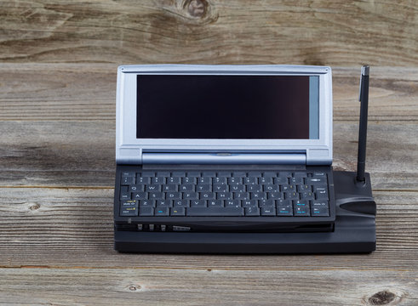
Explaination(1)
Mini computers:- It is smaller in size than
a mainframe computer. This makes them less expensive to maintain and simpler to fit into smaller places. It is less expensive than a super and mainframe computer.

Slide 10
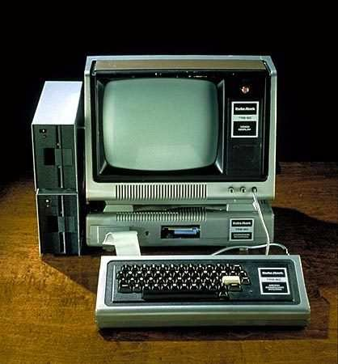
Explaination(2):-
Micro computers:- A microcomputer is a complete computer on a small scale, designed for use by one person at a time. An antiquated term, a microcomputer is now primarily called a personal computer (PC), or a device based on a single-chip microprocessor. Common microcomputers include laptops and desktops.

Slide 11
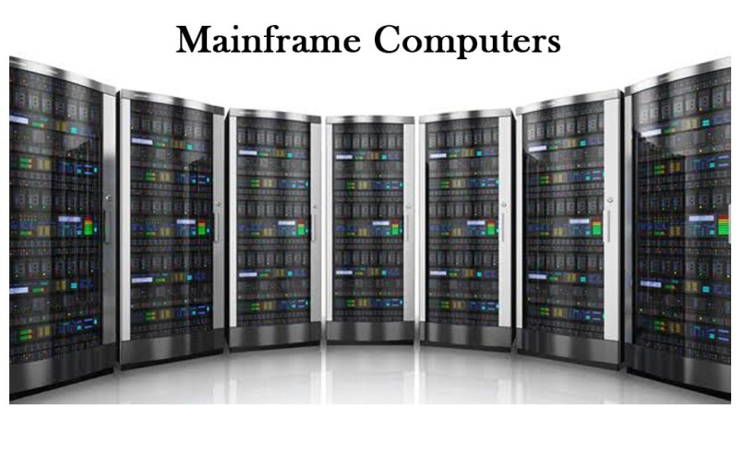
Explaination(3):-
Mainframe computers:- A mainframe computer, informally called a mainframe or big iron, is a computer used primarily by large organizations for critical applications like bulk data processing for tasks such as censuses, industry and consumer statistics, enterprise resource planning, and large-scale transaction processing.

Slide 12
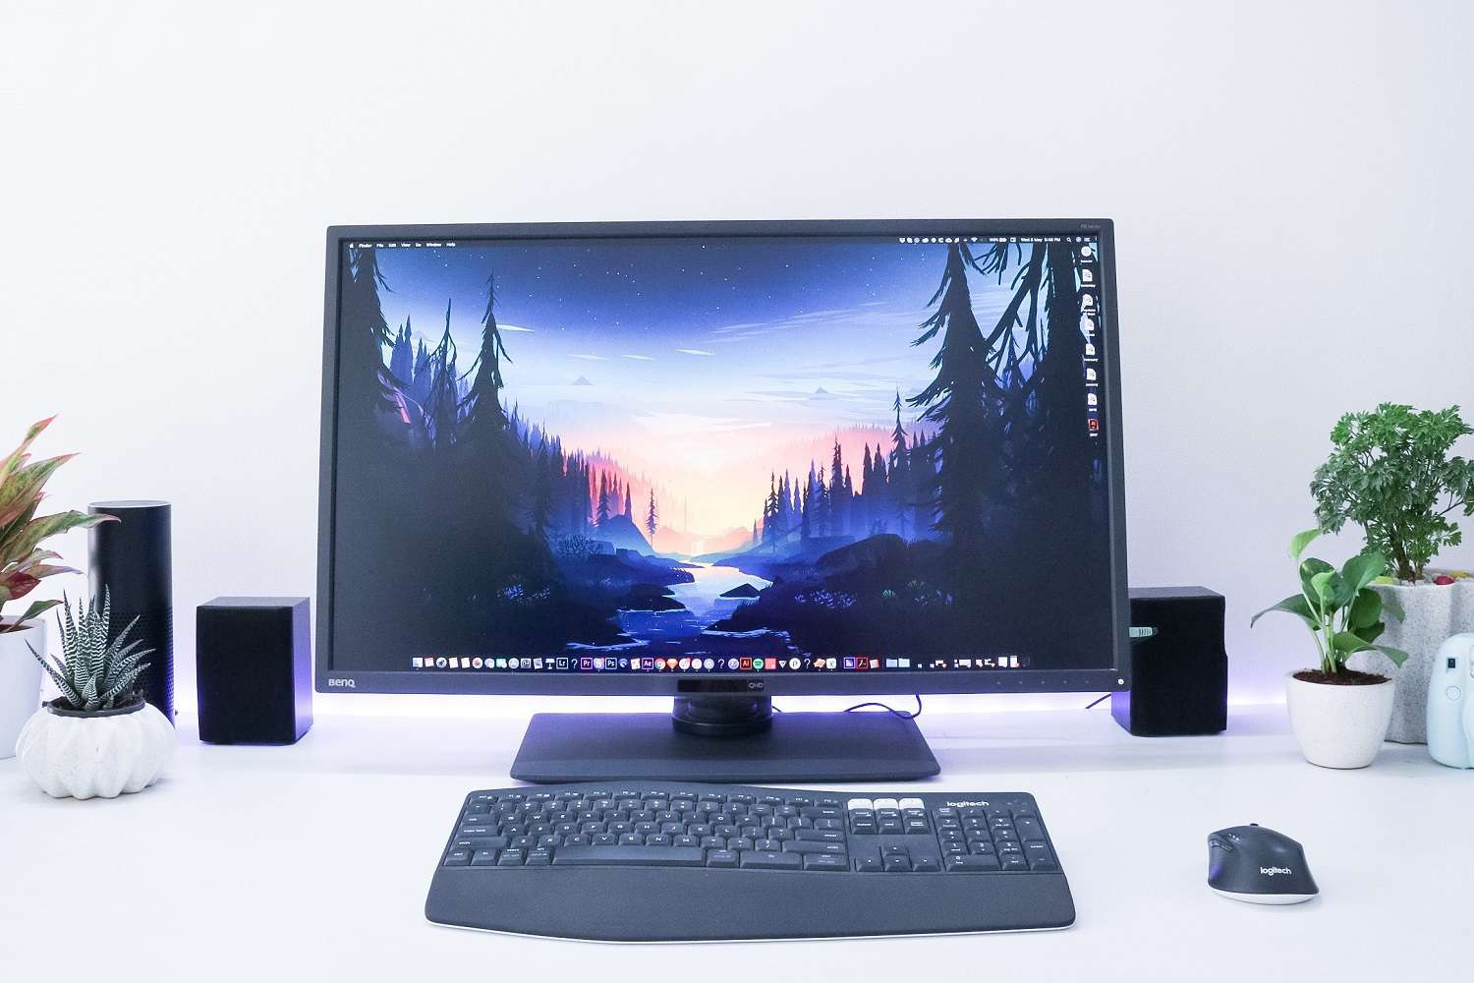
Explaination(4):-
Super & personal computers:- A personal computer (PC) is a digital device designed for personal purposes, such as working, studying, gaming, and browsing the internet. A typical PC consists of several hardware components, such as a motherboard, processor, memory, storage, and input/output devices, such as a monitor, keyboard, and mouse.

Slide 13
Etymology of computers:-
It was not until the mid-20th century that the word acquired its modern definition; according to the Oxford English Dictionary, the first known use of the word computer was in a different sense, in a 1613 book called The Yong Mans Gleanings by the English writer Richard Brathwait "I have read the truest computer of Times, and the best Arithmetician that euer [sic] breathed, and he reduceth thy dayes into a short number." This usage of the term referred to a human computer, a person who carried out calculations or computations. The word continued with the same meaning until the middle of the 20th century. During the latter part of this period women were often hired as computers because they could be paid less than their male counterparts. By 1943, most human computers were women.

Slide 14
GENERATIONS OF COMPUTER:-
The generations of computers are typically divided into five distinct phases:
First Generation: Vacuum Tubes.
Second Generation: Transistors.
Third Generation: Integrated Circuits.
Fourth Generation: Microprocessors.
Fifth Generation: Artificial Intelligence

Slide 15
NETWORKING & INTERNET:-
Computers have been used to coordinate information between multiple locations since the 1950s. The U.S. military's SAGE system was the first large-scale example of such a system, which led to a number of special-purpose commercial systems such as Sabre. In the 1970s, computer engineers at research institutions throughout the United States began to link their computers together using telecommunications technology. The effort was funded by ARPA (now DARPA), and the computer network that resulted was called the ARPANET. The technologies that made the Arpanet possible spread and evolved.

Slide 16
COMPUTER MEMORY:-
RAM, which stands for random access memory, and ROM, which stands for read-only memory, are both present in your computer.
Rom, ROM (read-only memory) is a non-volatile memory type. This means it receives data and permanently writes it on a chip, and it lasts even after you turn off your computer. The data is coded to not be overwritten, so it's used for things like your printer software or your startup programs

